Slide 1
Native Android Apps in C# with Xamarin
Alejandro Ruiz
Microsoft & Xamarin MVP
CTO @ Los Xamarinos
@alejandroruizva

Slide 2

Develop
Notes:
Xamarin is your complete mobile solution.
Xamarin Platform is usually what you hear about which is building native iOS, Android, Mac, and Windows Apps all in C#
However Xamarin offers a wide range of products for developers to go mobile including Test Cloud, Hockey App, and a way to learn all of mobile with University.

Slide 3
Why Xamarin
Notes:
Let’s talk a bit about C# and why it is awesome.

Slide 4
Notes:
Xamarin IS
Native User Interface: Apps need to look and act correct per platform.
Full SDK Access: As a developer we need to add the latest and greatest features
Native Performance: Needs to be fast and fluid

Slide 5
Xamarin is included
in Visual Studio
Notes:
Including the Free Community Edition

Slide 6


Slide 7
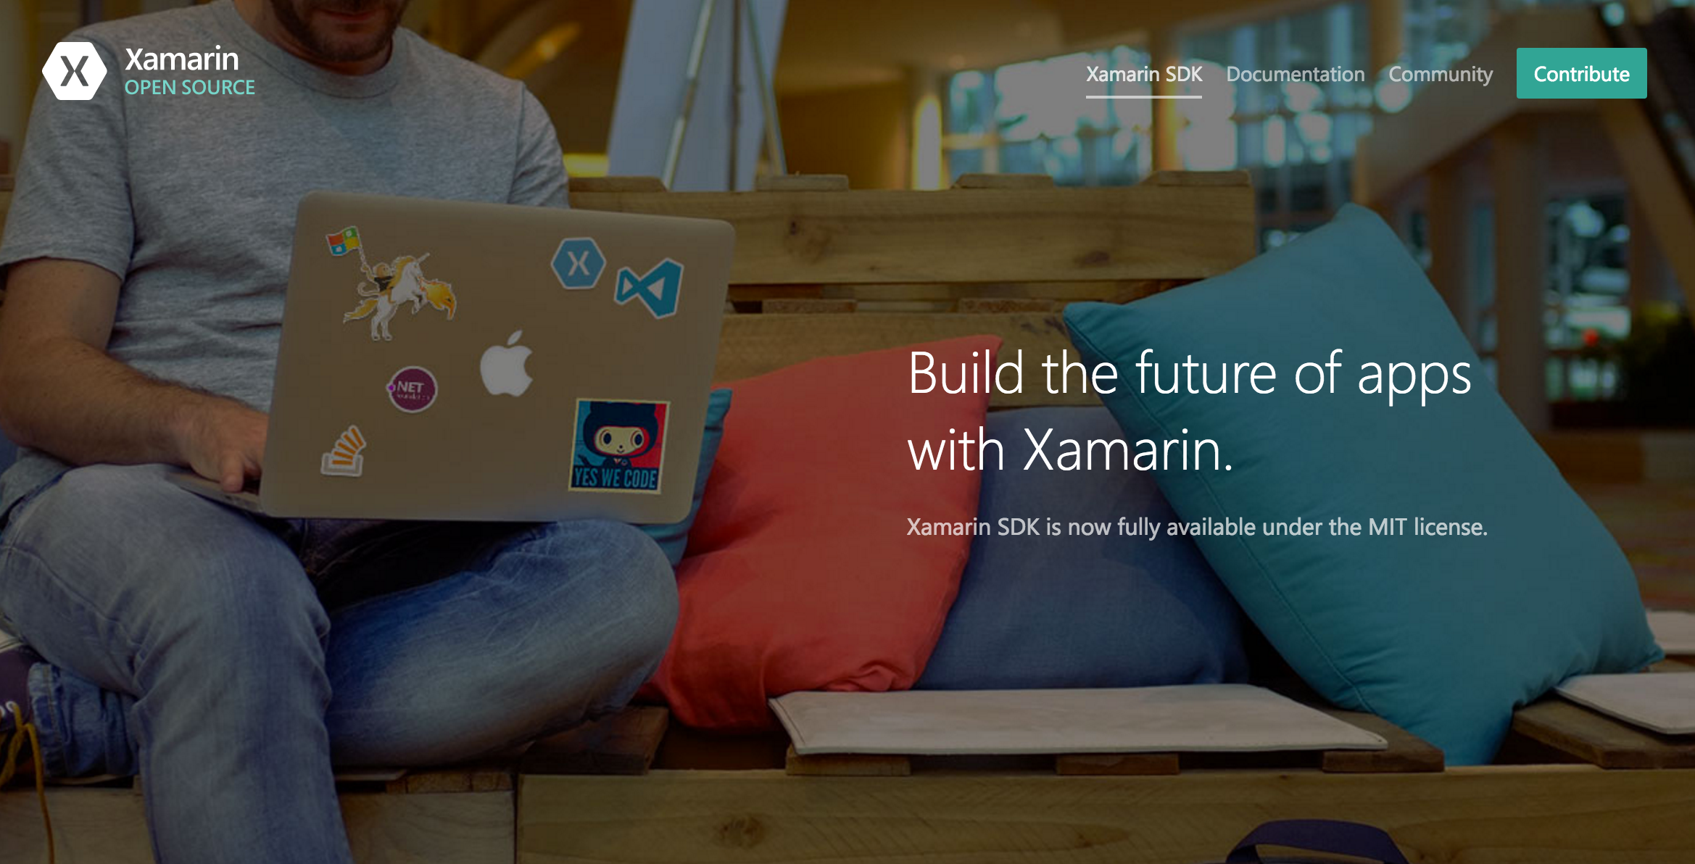
Open Source – open.xamarin.com

Slide 8
Open Source
Xamarin.iOS
Xamarin.Mac
Xamarin.Android
Xamarin.Forms
Bindings & Plugins
Getting Started
Contribution Guides

Slide 9

Write Everything in C#
C# Now Runs on 2.6+ Billion Devices

Slide 10
Why C#?
Notes:
Let’s talk a bit about C# and why it is awesome.

Slide 11

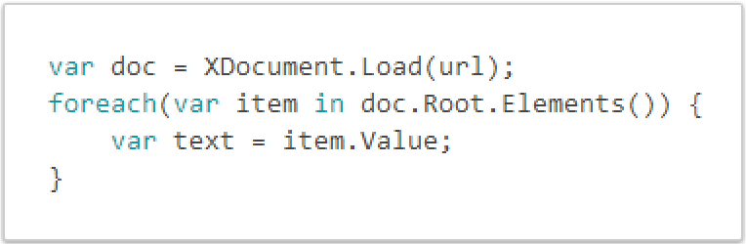
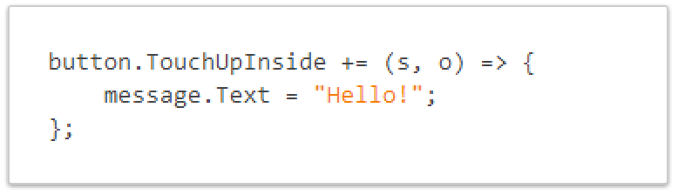
C# is Awesome
LINQ Support
Work with XML Easily
Event Handling & Delegates

Slide 12

JSON Made Easy
Json.NET offers simple conversations to/from JSON strings and .NET objects:
Notes:
Use your favorite libraries like Json.NET!

Slide 13
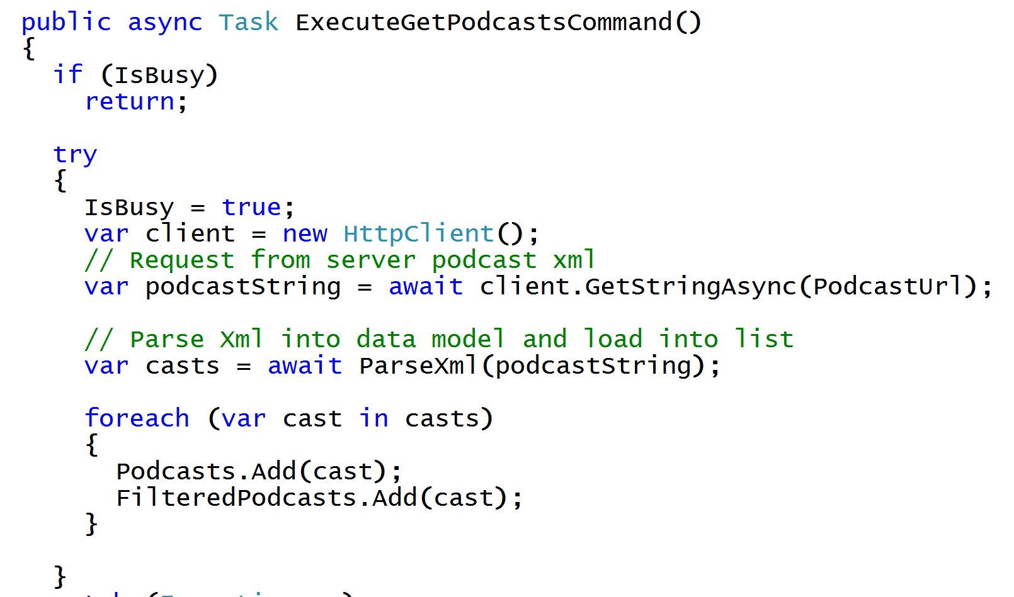
Async/Await
Write Beautiful & Maintainable Code
Notes:
The async and await keywords in C# 5.0 now available to Xamarin developers make asynchronous programming incredibly pleasant.
You end up with code that is much more linear and much easier to understand.
The compiler does a lot of magic for you which simplifies your code and your life.

Slide 14
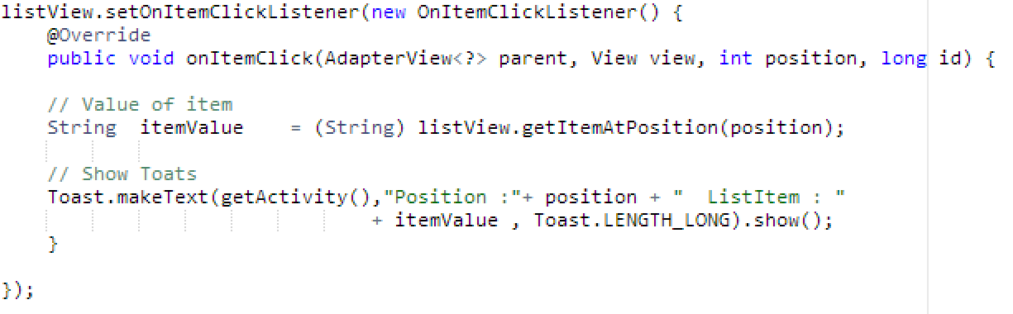
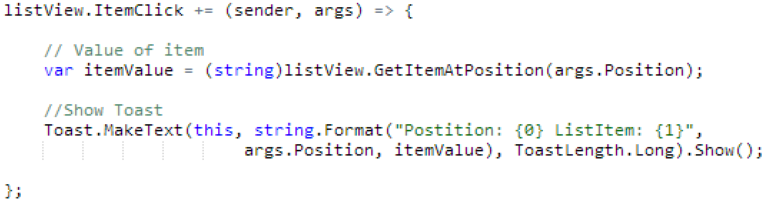
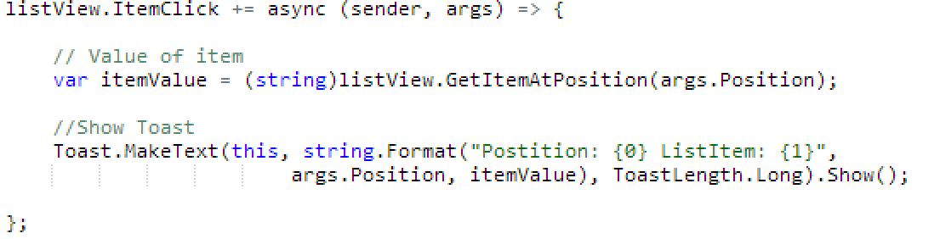
See the Difference – Android ItemClick
Java
C# with Xamarin
C# & Async with Xamarin
Notes:
Here we can see how easy it is just to do a += for an event and not have to implement a bunch of listeners every time. Easy to read, string.Format, using args, etc.
In fact we can make this call Async/Await by just adding async to the delegate!

Slide 15
How Xamarin Works

Slide 16
Android – 100% API Coverage
Text-to-speech
ActionBar
Printing Framework
Renderscript
NFC
System.Net
System
System.IO
System.Linq
System.Xml
System.Data
System.Windows
System.Numerics
System.Core
System.ServiceModel
Notes:
The same is true for Android as well.

Slide 17
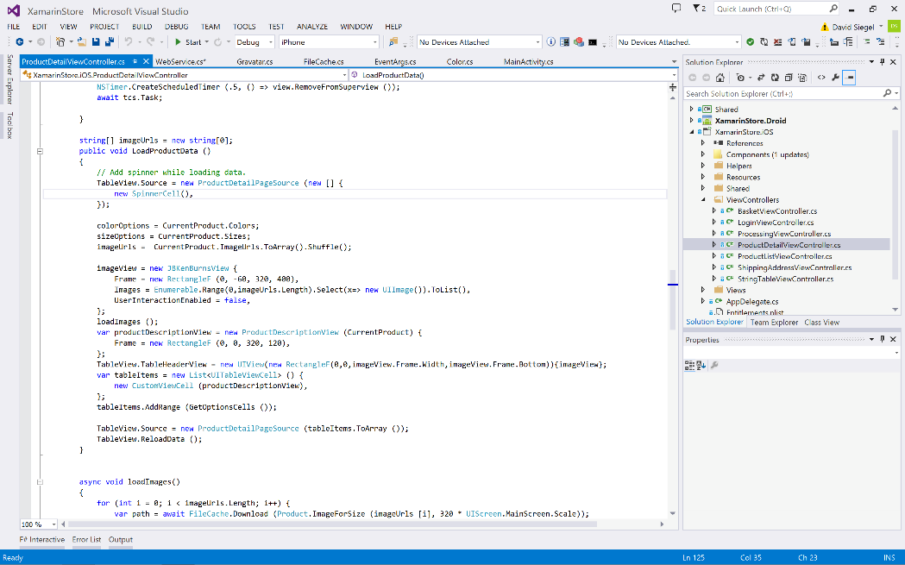
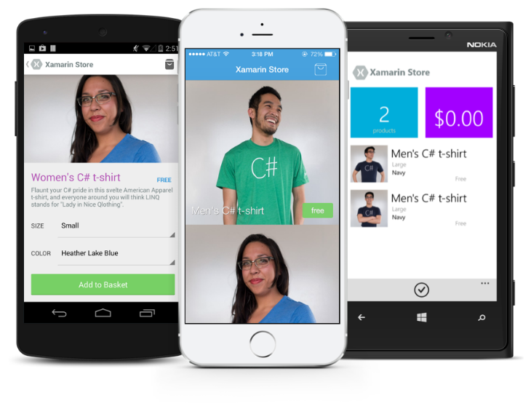
Anything you can do in Java can be done in C# and Visual Studio with Xamarin.

Slide 18
Native Performance
Xamarin.Android takes advantage of Just In Time (JIT) compilation on the Android device.
Notes:
There is no compromise on performance.
Xamarin apps look and feel native because they are native.

Slide 19
✓Always Up-to-Date
Full support for:
Google Glass
Android Wear
Amazon Fire TV
and much more
Notes:
Apple has a developer preview where Xamarin has alphas ready. Google does not offer this.
Android versions are usually 4 to 8 weeks out for a stable release, but alphas and betas are usually earlier.
Xamarin realizes how important having iOS ready because within 24 hours a large portion of iOS users upgrade
Android on the other hand is much different. After 4 months on the market Android 4.4 only had 1% adoption

Slide 20
Sharing Code

Slide 21
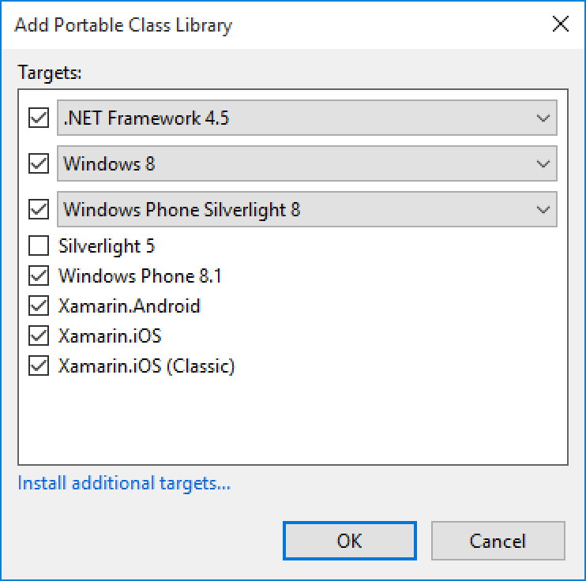
Portable Class Libraries
1 Assembly
Multiple Platforms
Including:
Xamarin.Android

Slide 22
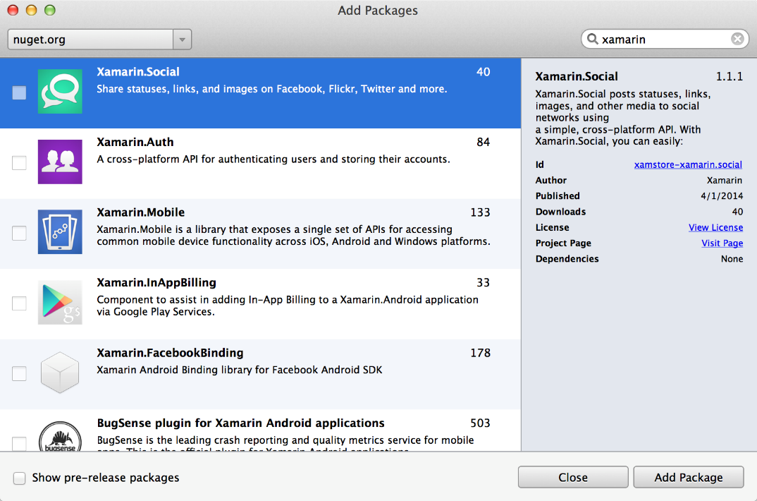
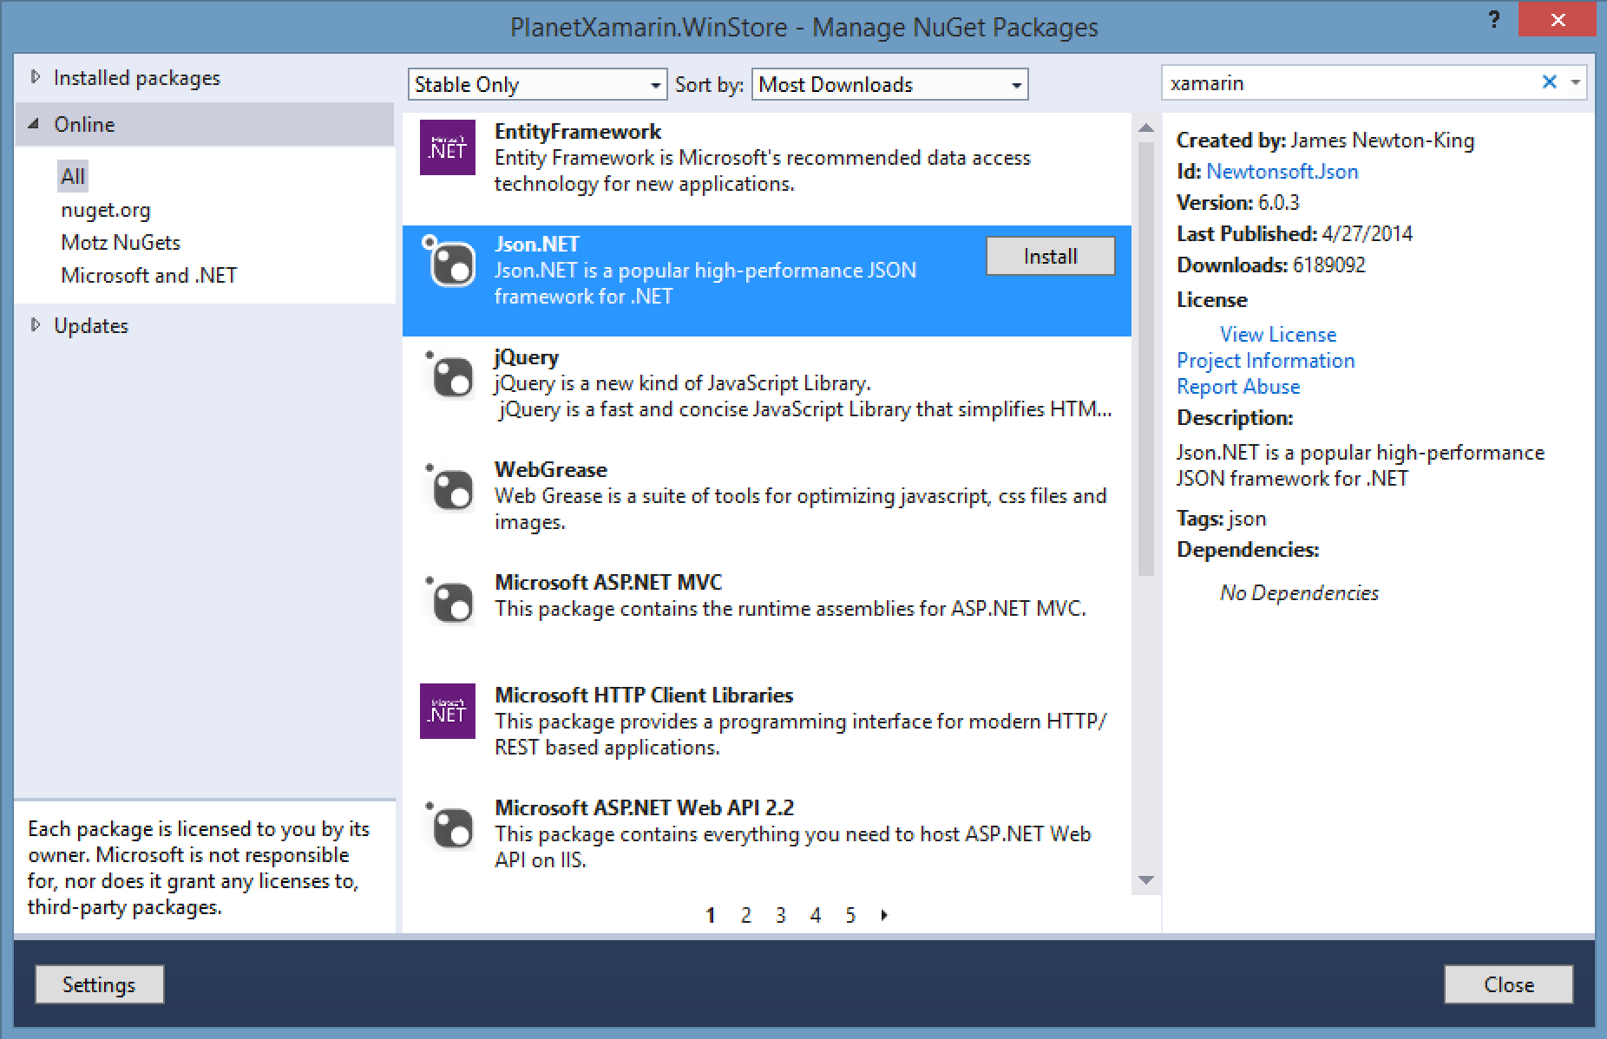
NuGet
Notes:
Use all of your favorite libraries from NuGet or share and distribute your own!

Slide 23
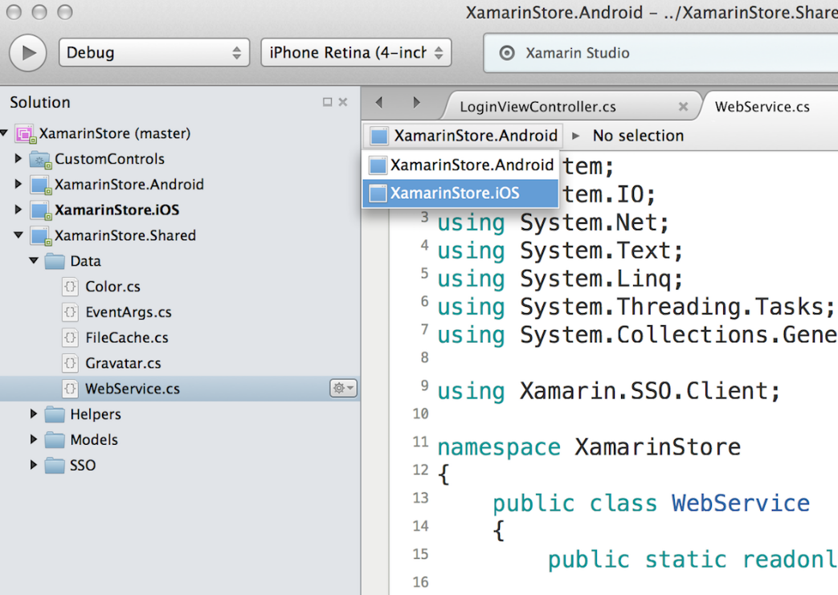
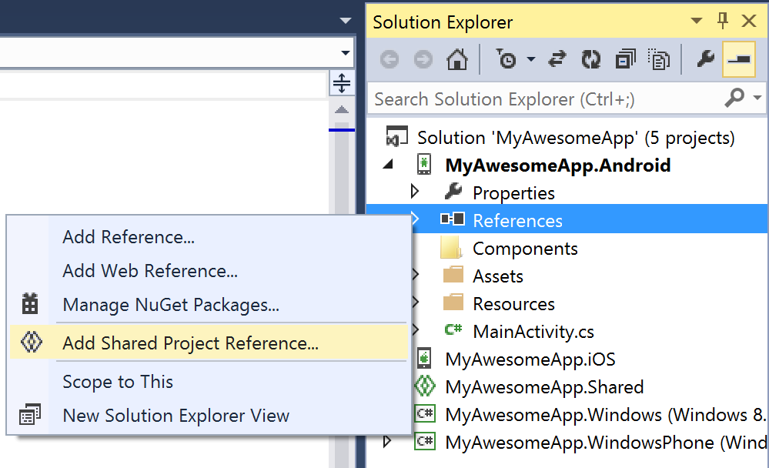
Shared Projects

Slide 24
Development Experience

Slide 25

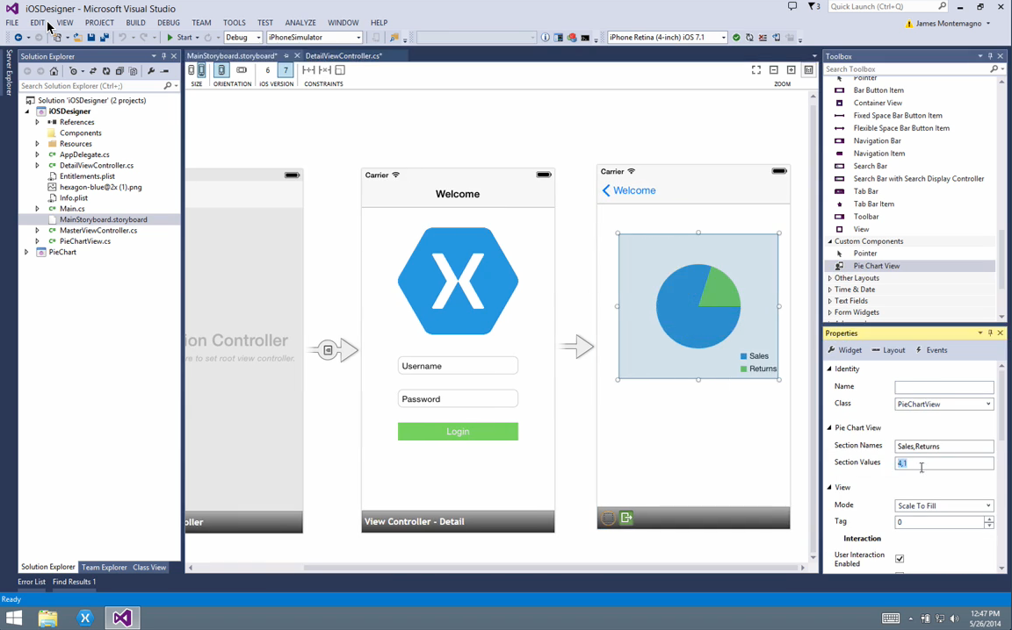
Visual Studio Integration
Notes:
Single Solution for iOS, Android, and Windows
Leverage Entire Microsoft Ecosystem:
ReSharper
Team Foundation Server
Azure
ASP.NET
Favorite Code Coverage and Profiling Tools
Starter Compatible
Visual Studio 2012, 2013, and 2015 including Community Edition

Slide 26
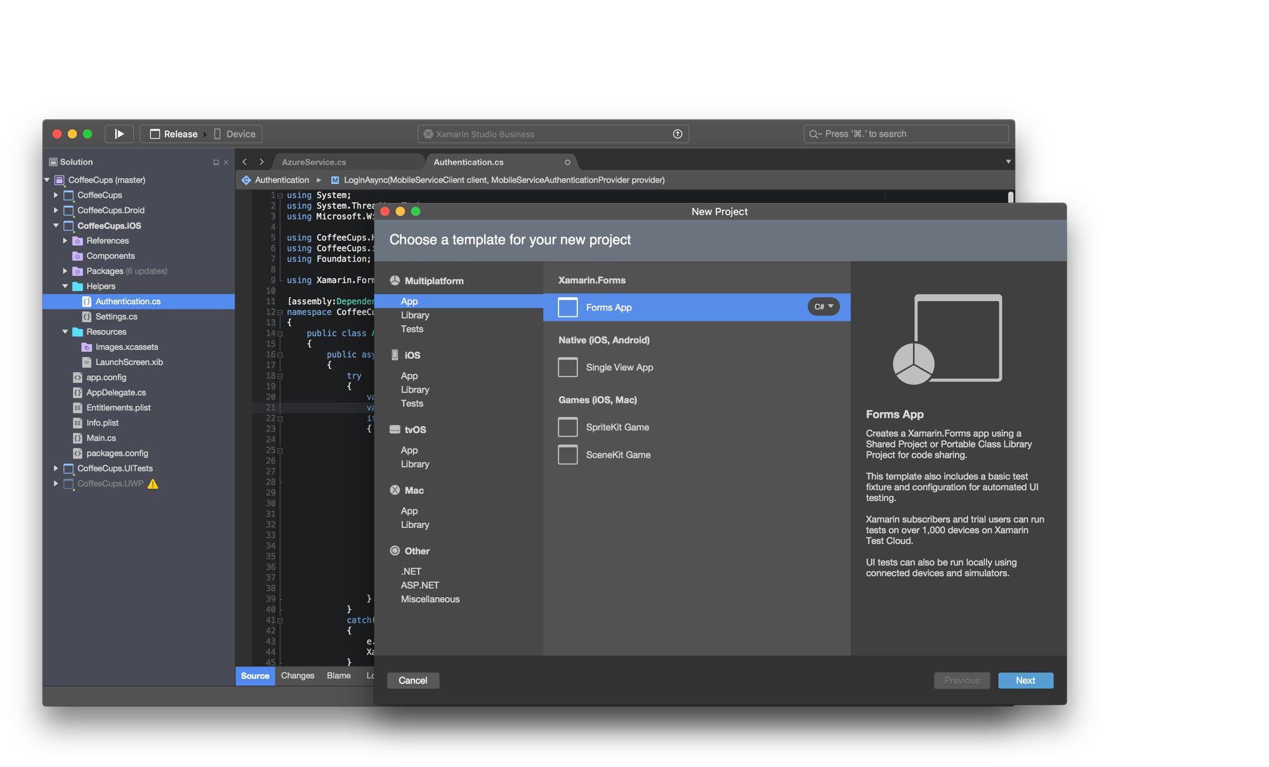
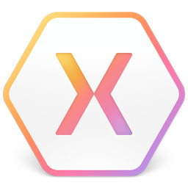
Xamarin Studio – Mac
Notes:
Xamarin Studio on Mac offers: Android, iOS and Mac development
World Class IDE with great features:
Code Analysis
Upload to Test Flight
Git & Subversion Integration
Code Completion
Code Navigation
Easy transition from Visual Studio
The same Solution & Projects open in BOTH Xamarin Studio and Visual Studio!

Slide 27

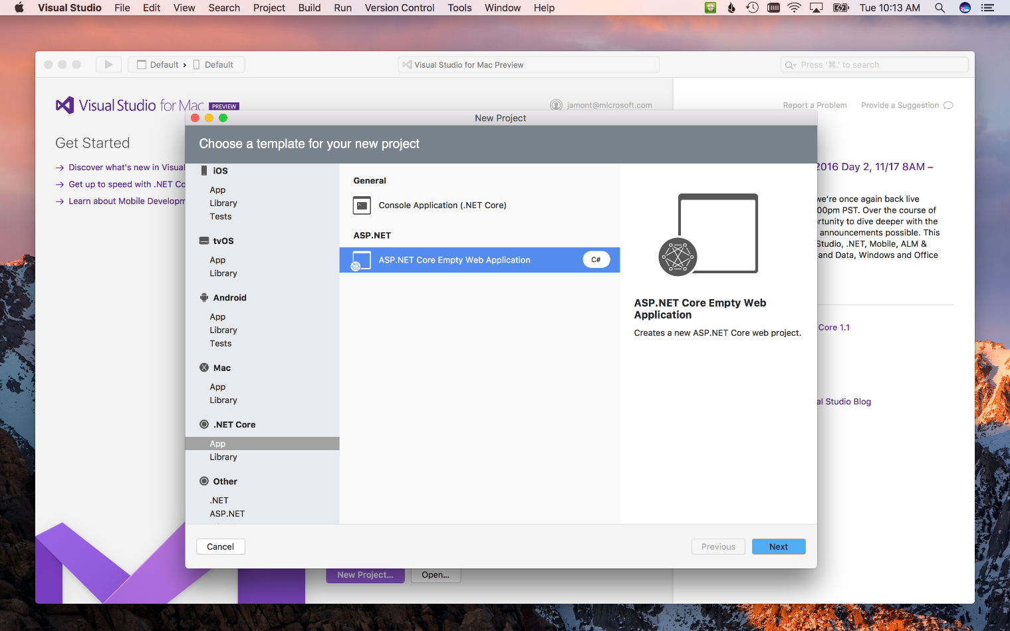
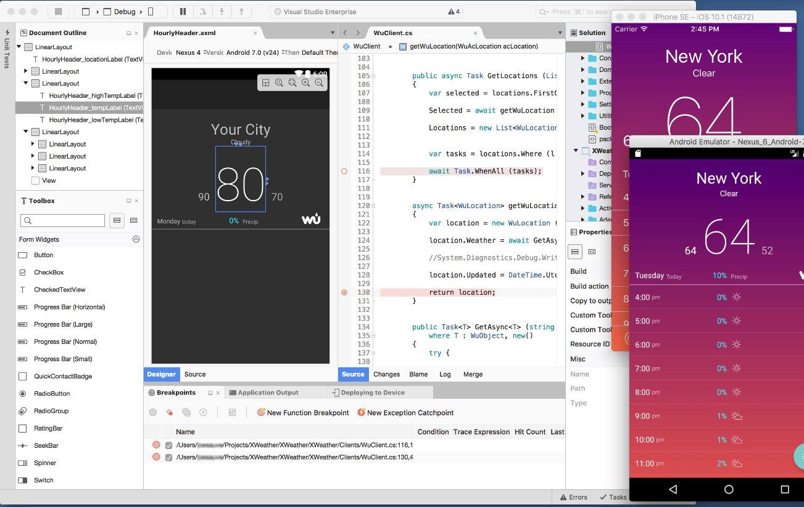
Visual Studio for Mac (Preview)
iOS, Android, & macOS
.NET development
.NET Core & ASP.NET Core
Tools for Azure
Notes:
Xamarin Studio on Mac offers: Android, iOS and Mac development
World Class IDE with great features:
Code Analysis
Upload to Test Flight
Git & Subversion Integration
Code Completion
Code Navigation
Easy transition from Visual Studio
The same Solution & Projects open in BOTH Xamarin Studio and Visual Studio!

Slide 28
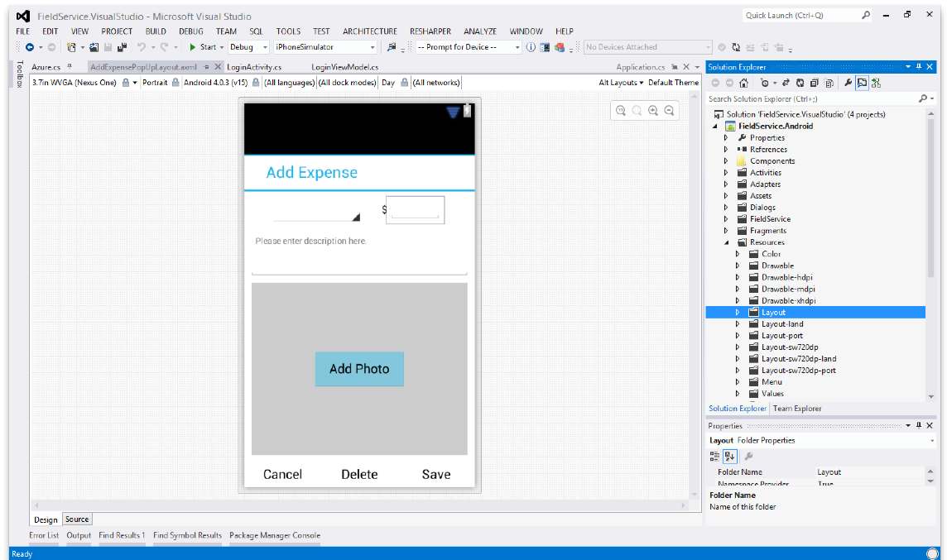
Android Designer
Available in:
Xamarin Studio
Visual Studio
Create UI with drag & drop simplicity
Target multiple screen sizes, resolutions and Android versions
Layouts saved in standard Android XML files

Slide 29
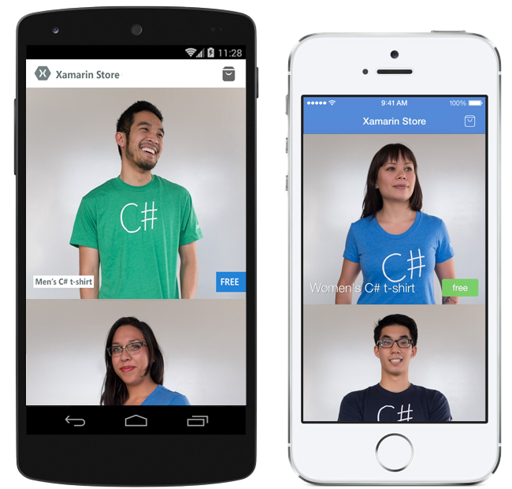


Pre-built App Templates
Xamarin.com/prebuilt
My Shoppe
Connect with consumers
Store Application
Moments
Photo Sharing App
Notes:
If you are looking to get started will a full baked application simply head over to Xamarin’s pre-built page featuring these apps and many more!

Slide 30
Let’s take a look Download: https://goo.gl/ASy6SI

Slide 31




Microsoft’s complete mobile DevOps solution
Develop
Test
Build
Distribute
Monitor

Slide 32
Live Update
Crash Reporting
A/B Testing
Storage
Identity
Push Notifications
Remote Config.
Tables

Slide 33
Push Notifications
Visual Studio Mobile Center
A/B Testing
Crash Reporting
Remote Config.
Identity
mobile.azure.com
Tables
Live Update
Storage

Slide 34
Get Started Today
xamarin.com
Notes:
Get started today with free 30 day trial of Xamarin at xamarin.com

Slide 35
Unrivaled Mobile Development Training
Live unlimited mobile development training from mobile experts, in your time-zone, on your schedule, and as often as you'd like.
Free 30 Day Trial - xamarin.com/university

Slide 36
Thank You! Questions?
Presenter
Alejandro Ruiz
Microsoft/Xamarin MVP & CTO @ Los Xamarinos
alejandro@alejandroruizvarela.com
alejandroruizvarela.blogspot.com
@alejandroruizva

